Slide 1

TEAM 2
Regression Analysis Project
김광준 홍창휘 이한솔 정민정

Slide 2


Slide 3
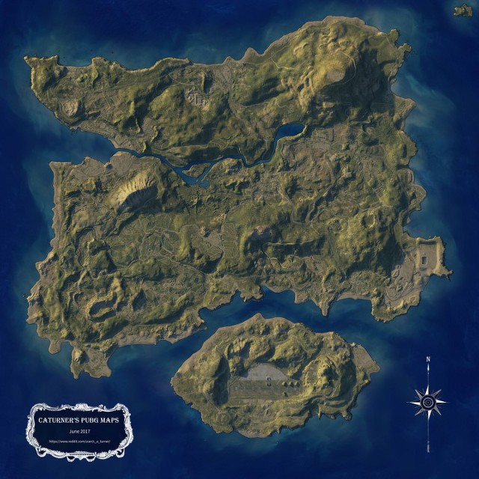

Slide 4
Target
Win Place Percentage
0
≤
≤
1
0
1

Slide 5
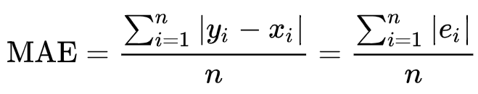
Evaluation - MAE
(Mean Absolute Error)

Slide 6
Data Set
Ids
Id groupId matchId
고유번호
그룹번호
매치번호
Train
4,446,966
2,026,745
47,965
Test
1,934,174
886,238
20,556

Slide 7
Data Set
Points
killPoint winPoint
rankPoint

Slide 8
Data Set
Kills
match
etc.
Headshot Kill
Kills
Teamkill
Roadkill
Longest kill
Distance
Items
Revives
Heals
Damage dealt
Match Duration
Match Type
Number of Groups
Max Place

Slide 9
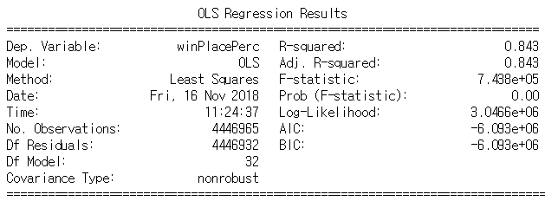
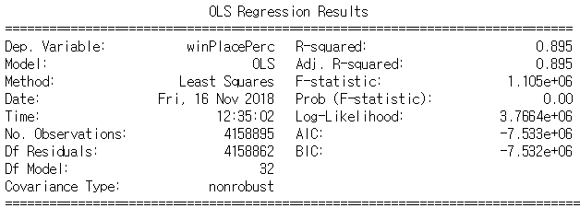
Final Result
MAE Change : 0.088850 0.07535
OLS Result Change
Notes:
결과넣기

Slide 10
Two types:
- kill & win Points
- Rank Points
Pointing
System
Cheaters
w/ Hack
How related?
Aim Hack
Kill Hack
Speed Hack
Hackers & Outliers
Multi-
collinearity
Multi-
collinearity
How to trace?

Slide 11
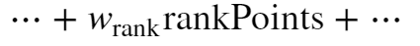
Pointing System
killPoint winPoint
rankPoint
0
0
1000~5000
250~1500
0 or -1
0

Slide 12
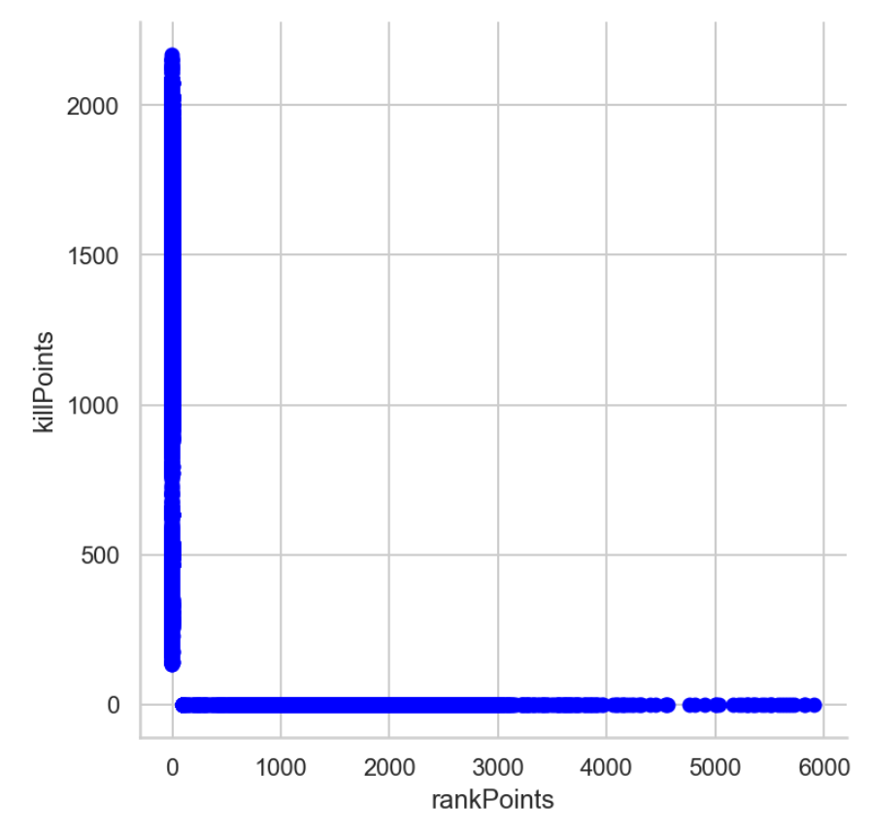
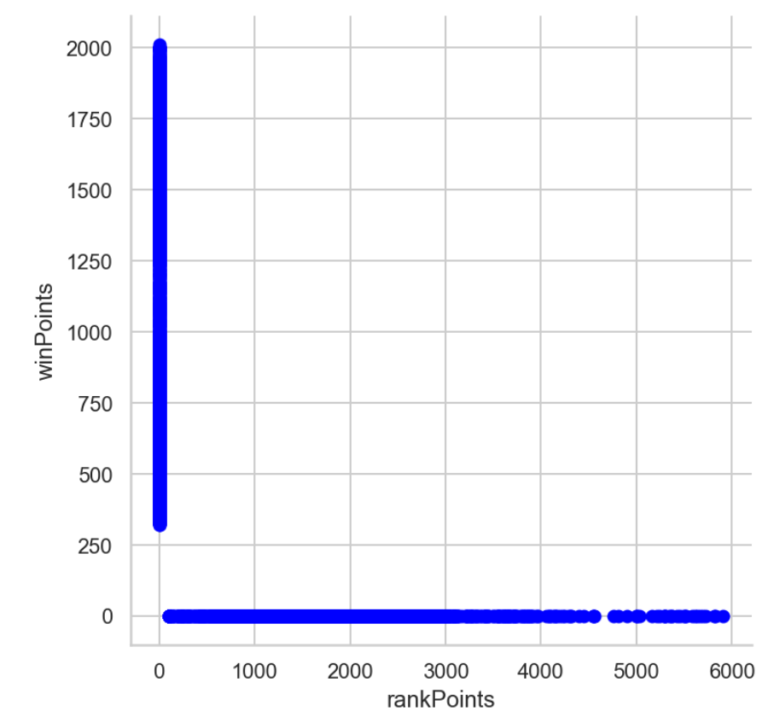
Pointing System
rank Point System : 59.72%

Slide 13
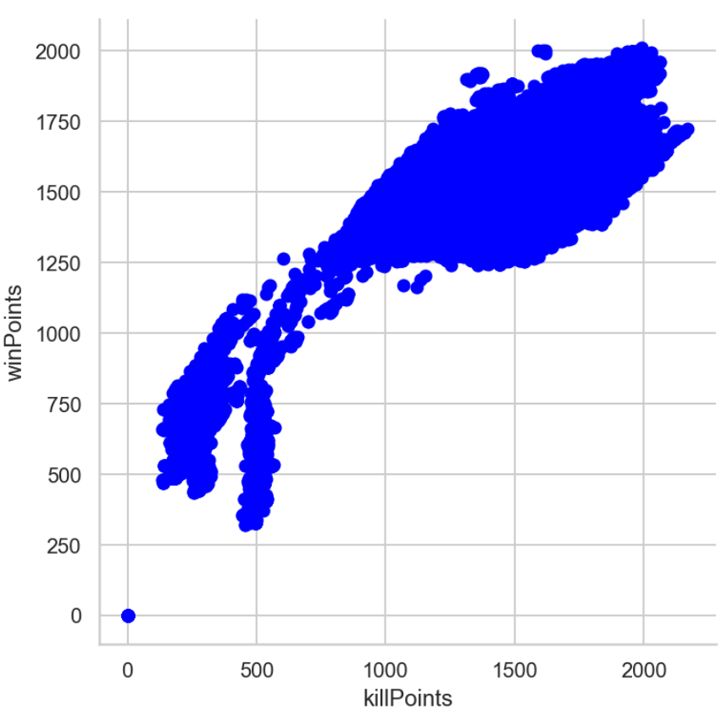
Pointing System
kill-win Point System : 40.28%

Slide 14
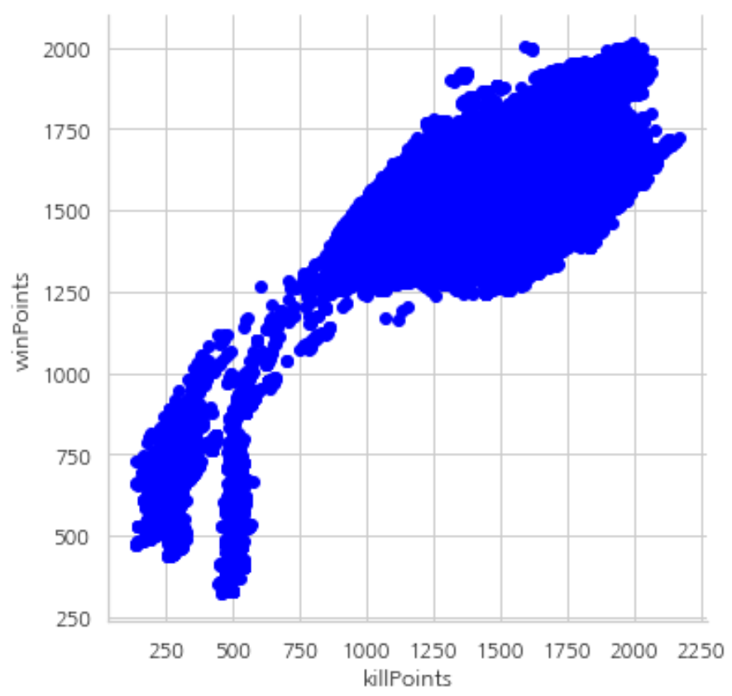
Pointing System
killPoint / winPoint
rankPoint
Correlation = 0.44
Separate Model
Separate scaling

Slide 15
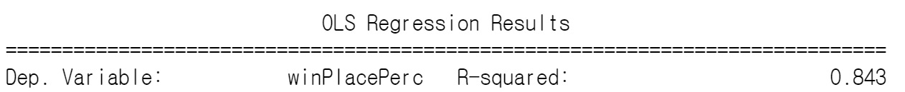
R-squared
Pointing System
rankPoint
Separate Model
killPoint
winPoint
Separate scaling

Slide 16
MAE
Pointing System
Separate scaling
Separate Model
1
All-scaling : 0.088859 (MAE)
3
Separate-model : 0.088767 (MAE)
2
separate-scaling : 0.088850 (MAE)
Notes:
모델 두 가지로 나눠서 해봤고, scaling만으로 나눠서 해봤다. 결과는 나눠서 하는게 더 좋긴함. 두 가지방식 다 하려고했지만 시간상문제로 통합한걸로 갔다.

Slide 17
Hackers
Outliers

Slide 18
Hackers
1
(Damage Dealt == 0) & (kills >= 1) : 4,153
Total distance
= walk distance
+ ride distance
+ swim distance
2
(Total Distance == 0) & (kills >= 1) : 1,535
3
(Total Distance == 0) & (item >= 1) : 18,963
Items
= heals + boosts
+ weapon
4
(ride Distance == 0) & (roadKill >= 1) : 186
23,331 (0.52%)
Notes:
비선형 : 함수를 만들어서 cv를 시도해봤으나 시간이 너무 오래걸려서 완성 못함

Slide 19
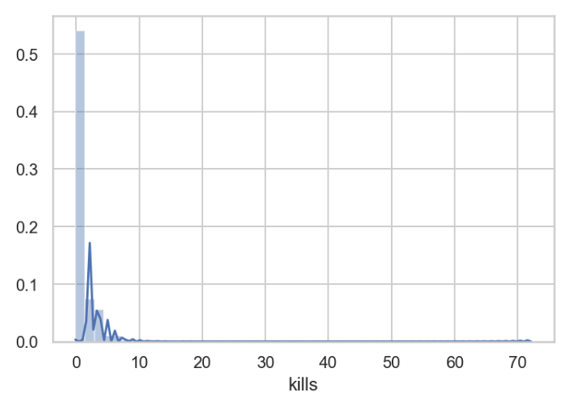
Outliers
99%

Slide 20
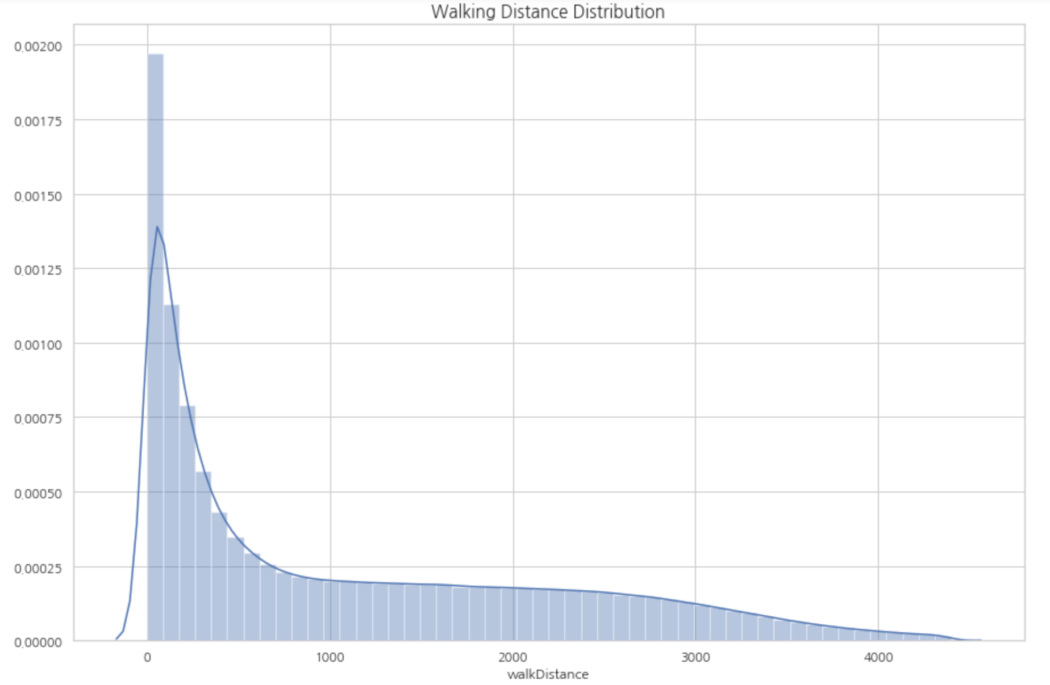
Outliers

Slide 21
Fox Outlier Recommendation
Outliers
270,838
Notes:
num/max
Cv
전처리

Slide 22
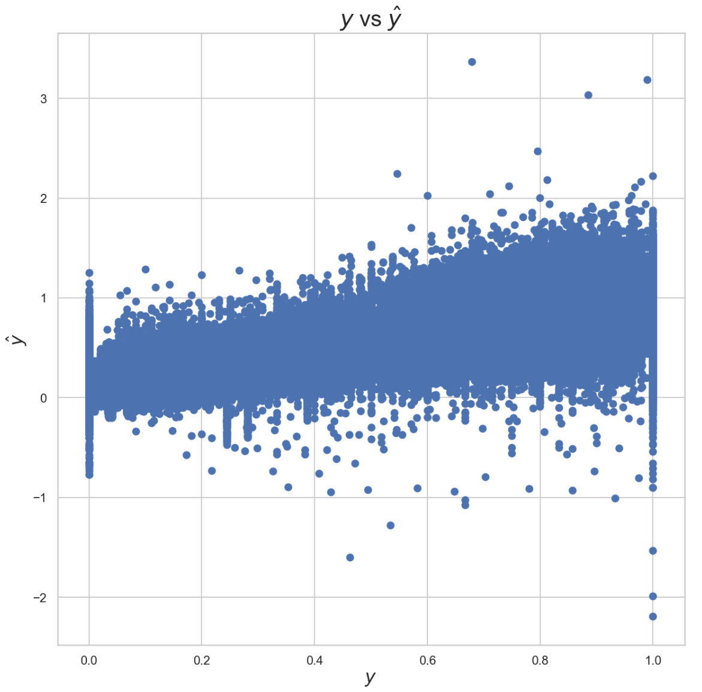
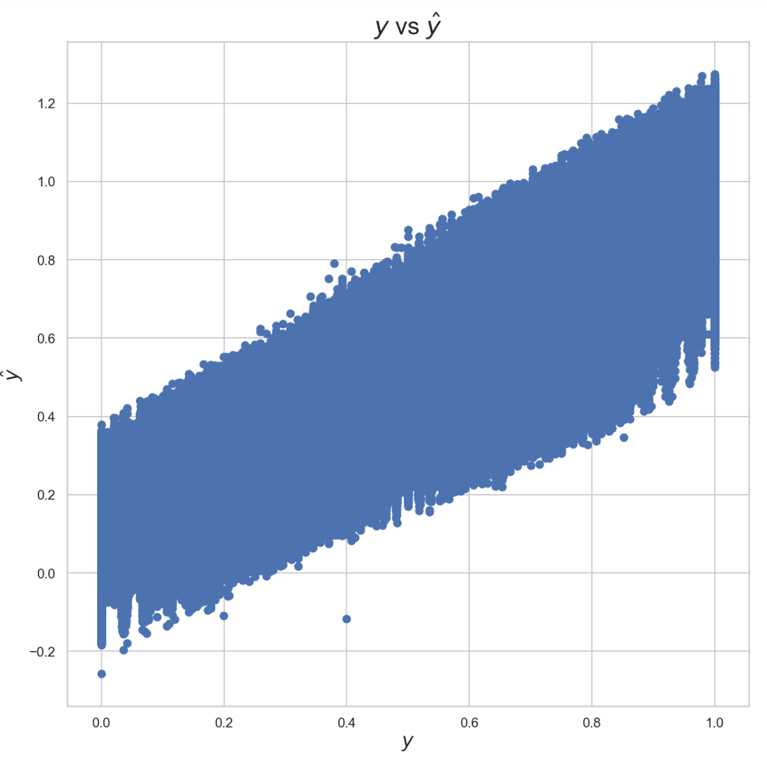
Fox Outlier Recommendation
Outliers

Slide 23
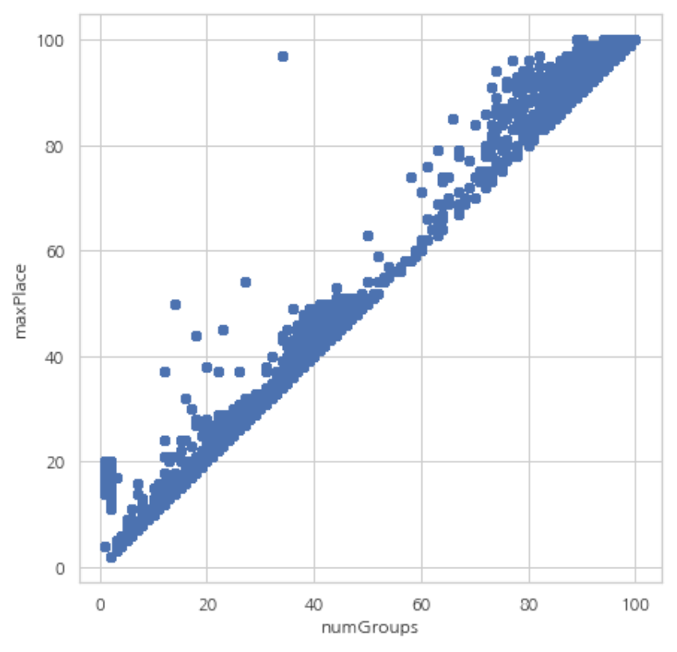
Multicollinearity
- numGroups & match Type

Slide 24
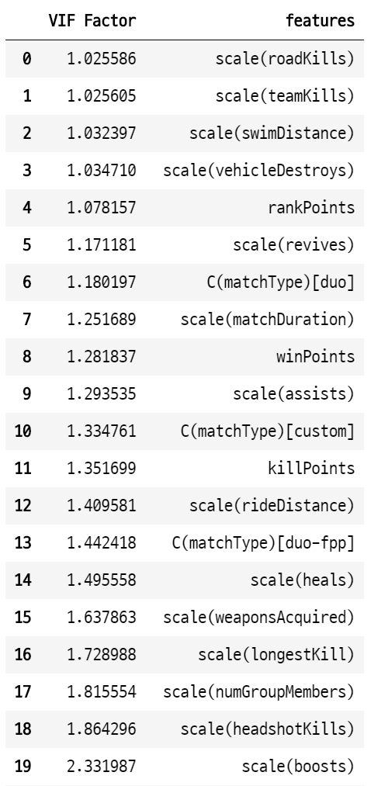
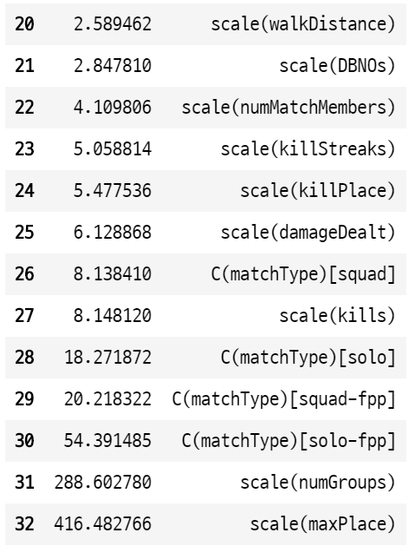
Multicollinearity
- VIF

Slide 25
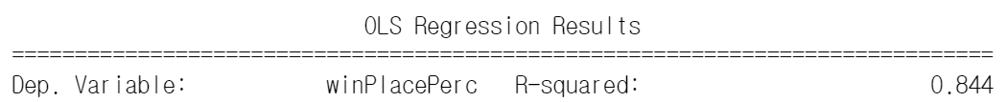
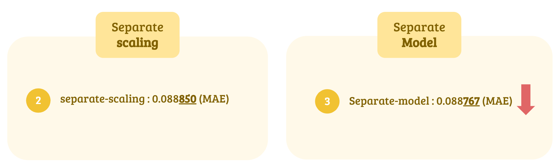
Multicollinearity
Remove column : MaxPlace
R-squared
MAE
0.08869
CV
0.08887

Slide 26
Data Pre-processing
Data type
Id groupId matchId
Index
그룹인원
매치인원

Slide 27
Data Pre-processing
Data type
Match Type
Normal
Custom
solo / solo-fpp
duo / duo-fpp
squad / squad-fpp
etc.

Slide 28
Data Pre-processing
NaN data

Slide 29
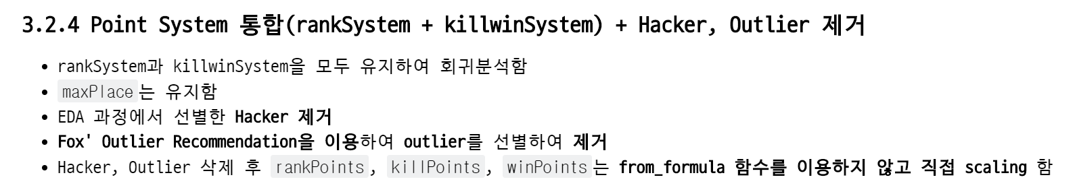
Final model
preview

Slide 30
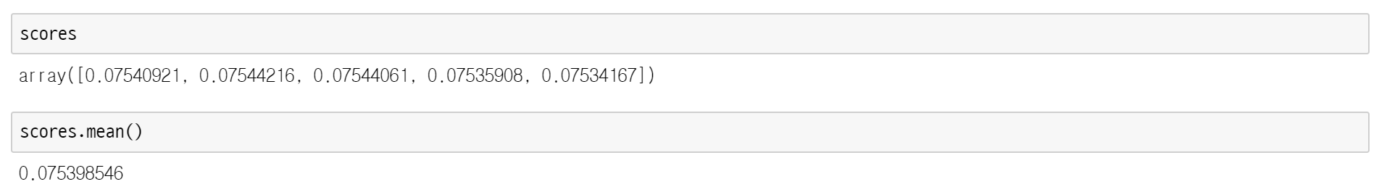
Final model
Cross Validation

Slide 31
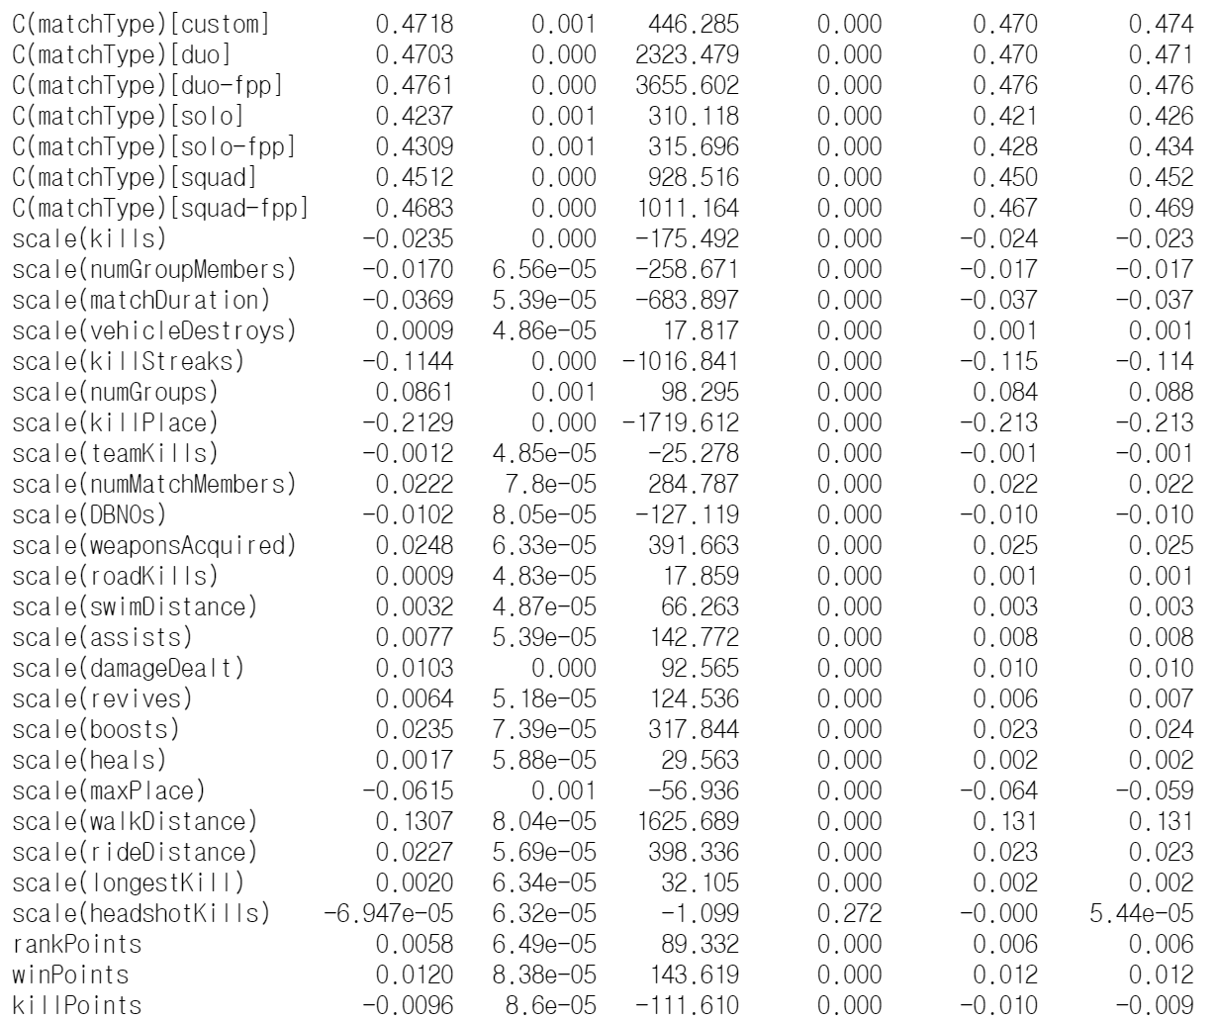
Final model
Model Summary

Slide 32
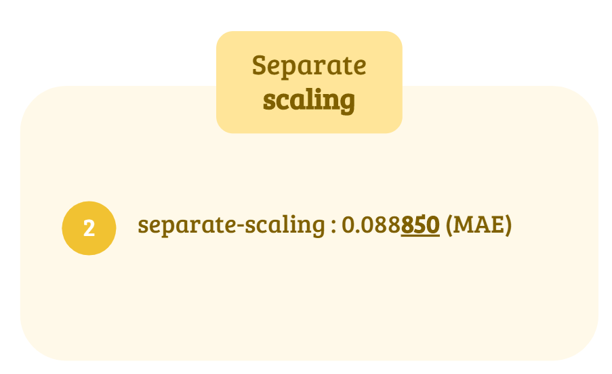
Final model
Final Result
R-squared
Model’s MAE
0.07535
MAE
0.08830
0.005

